Slide 1
Processes and Threads
Processes have two characteristics:
  Resource ownership - process includes a virtual address space to hold the process image
  Scheduling/execution - follows an execution path that may be interleaved with other processes
These two characteristics are treated independently by the operating system

Slide 2
Processes and Threads
The unit of dispatching is referred to as a thread or lightweight process
The unit of resource ownership is referred to as a process or task

Slide 3
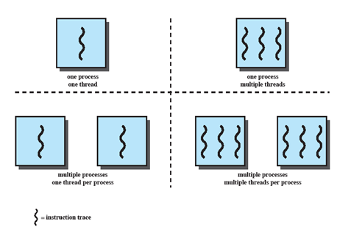
Multithreading
The ability of an OS to support multiple, concurrent paths of execution within a single process.
Notes:
Multithreading refers to the ability of an OS to support multiple, concurrent paths of execution within a single process.

Slide 4
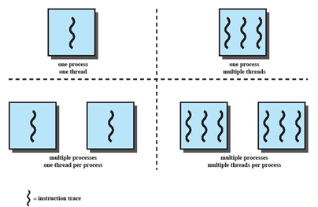
Single Thread
Approaches
MS-DOS supports a single user process and a single thread.
Some UNIX, support multiple user processes but only support one thread per process
Notes:
Animated Slide
Onload Enlarges top-left to discuss DOS
Click1: Enlarges bottom-left for Unix
Single Threaded approach: The traditional approach of a single thread of execution per process, in which the concept of a thread is not recognized, examples are
MS DOS (single process, single thread)
Unix (multiple, single threaded processes)

Slide 5
Multithreading
Java run-time environment is a single process with multiple threads
Multiple processes and threads are found in Windows, Solaris, and many modern versions of UNIX
Notes:
Animated Slide
Onload: Emphasis on top-right and JRE (single process, multiple thread),
Click 1: Emphasis on multiple processes with multiple threads – this is the main topic of this chapter
JRE is an example of a system of one process with multiple threads.
Of main interest in this chapter is the use of multiple processes, each of which support multiple threads.
Examples include:
Windows,
Solaris,
and many modern versions of UNIX.

Slide 6
Processes
A virtual address space which holds the process image
Protected access to
  Processors,
  Other processes,
  Files,
  I/O resources
Notes:
In a multithreaded environment, a process is defined as the unit of resource allocation and a unit of protection.

Slide 7
One or More Threads in Process
Each thread has
  An execution state (running, ready, etc.)
  Saved thread context when not running
  An execution stack
  Some per-thread static storage for local variables
  Access to the memory and resources of its process (all threads of a process share this)
Notes:
Within a process, there may be one or more threads, each with the following:
• A thread execution state (Running, Ready, etc.).
• A saved thread context when not running;
one way to view a thread is as an independent program counter operating within a process.

Slide 8
One view…
One way to view a thread is as an independent program counter operating within a process.

Slide 9

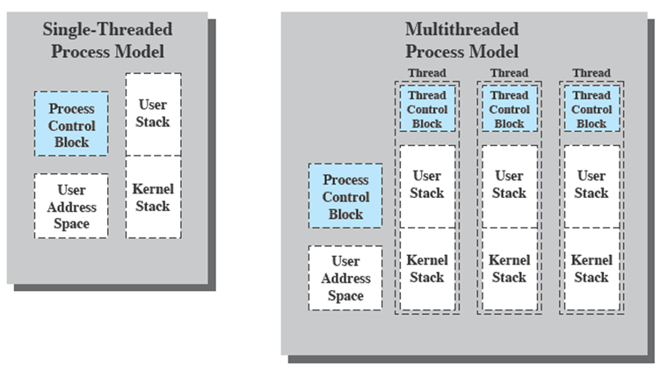
Threads vs. processes
Notes:
Distinction between threads and processes from the point of view of process management.
In a single-threaded process model, the representation of a process includes
its process control block
user address space,
user and kernel stacks to manage the call/return behaviour of the execution of the process.
While the process is running, it controls the processor registers. The contents of these registers are saved when the process is not running.
In a multithreaded environment,
there is still a single process control block and user address space associated with the process,
but separate stacks for each thread,
as well as a separate control block for each thread containing register values, priority, and other thread-related state information.
Thus, all of the threads of a process share the state and resources of that process.
They reside in the same address space and have access to the same data.
When one thread alters an item of data in memory, other threads see the results if and when they access that item.
If one thread opens a file with read privileges, other threads in the same process can also read from that file.

Slide 10
Distinction between threads and processes from the point of view of process management.
In a single-threaded process model, the representation of a process includes
  its process control block
  user address space,
  user and kernel stacks to manage the call/return behaviour of the execution of the process.
While the process is running, it controls the processor registers. The contents of these registers are saved when the process is not running.
In a multithreaded environment,
  there is still a single process control block and user address space associated with the process,
  but separate stacks for each thread,
  as well as a separate control block for each thread containing register values, priority, and other thread-related state information.
Thus, all of the threads of a process share the state and resources of that process.
  They reside in the same address space and have access to the same data.
  When one thread alters an item of data in memory, other threads see the results if and when they access that item.
  If one thread opens a file with read privileges, other threads in the same process can also read from that file.

Slide 11
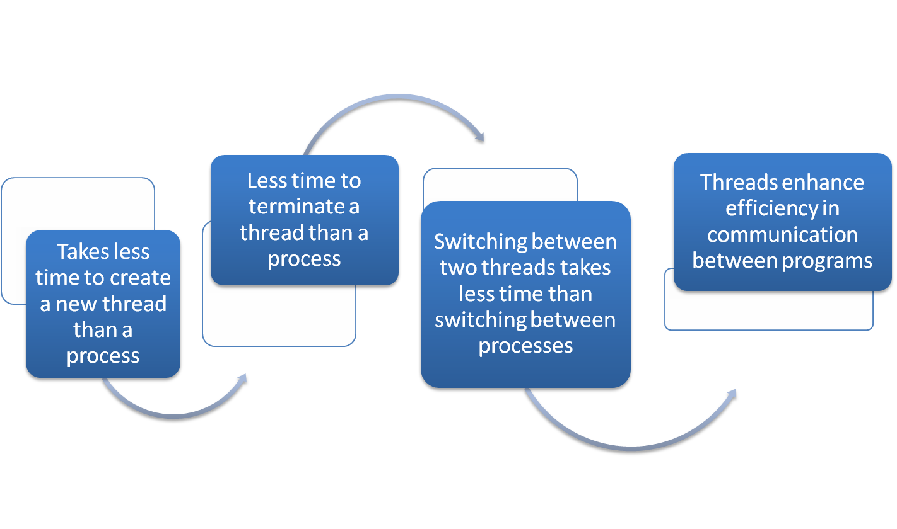
Benefits of Threads
Notes:
Thus, all of the threads of a process share the state and resources of that process. They reside in the same address space and have access to the same data. When one thread alters an item of data in memory, other threads see the results if and when they access that item. If one thread opens a file with read privileges, other threads in the same process can also read from that file.
The key benefits of threads derive from the performance implications:
1. It takes far less time to create a new thread in an existing process than to
create a brand-new process. Studies done by the Mach developers show that
thread creation is ten times faster than process creation in UNIX [TEVA87].
2. It takes less time to terminate a thread than a process.
3. It takes less time to switch between two threads within the same process than to switch between processes.
4. Threads enhance efficiency in communication between different executing programs. In most operating systems, communication between independent processes requires the intervention of the kernel to provide protection and the mechanisms needed for communication. However, because threads within the same process share memory and files, they can communicate with each other without invoking the kernel.
Thus, if there is an application or function that should be implemented as a set of related units of execution, it is far more efficient to do so as a collection of threads rather than a collection of separate processes.

Slide 12
Thread use in a
Single-User System
Foreground and background work(eg.spreadsheet)
Asynchronous processing(eg. as a protection against power failure, one can design a word processor to write its random access memory (RAM) buffer to disk once every minute. A thread can be created whose sole job is periodic backup and that schedules itself directly with the OS)
Speed of execution(eg.read and write together)
Modular program structure
Notes:
Foreground and background work
e.g. Spreadsheet
– one thread looking after display
Another thread updating results of formulae
Asynchronous processing
E.G. protection against power failure within a word processor,
A thread writes random access memory (RAM) buffer to disk once every minute.
this thread schedules itself directly with the OS;
no need for fancy code in the main program to provide for time checks or to coordinate input and output.
Speed of execution
- On thread can compute one batch of data while another thread reading the next batch from a device.
On a multiprocessor system, multiple threads from the same process may be able to execute simultaneously.
Even though one thread may be blocked for an I/O operation to read in a batch of data, another thread may be executing.
Modular program structure
- Threads make it easier to design programs which involve a variety of activities or a variety of sources and destinations of input and output.

Slide 13

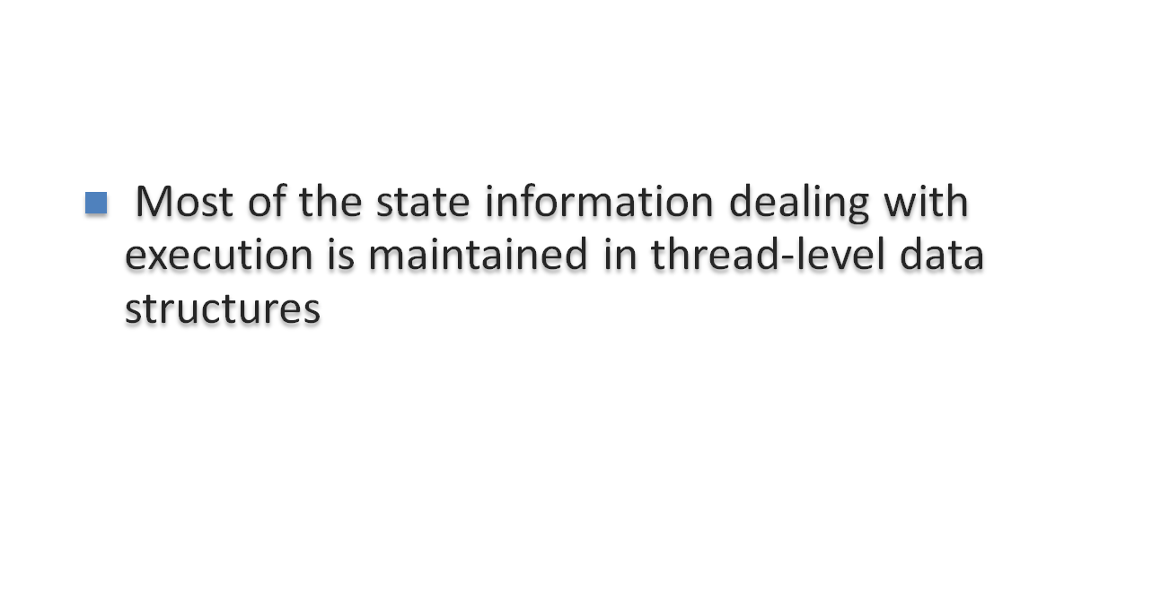
In an OS that supports threads, scheduling and dispatching is done on a thread basis
  suspending a process involves suspending all threads of the process
  termination of a process terminates all threads within the process
Notes:
In an OS that supports threads, scheduling and dispatching is done on a thread basis; hence, most of the state information dealing with execution is maintained in thread-level data structures. There are, however, several actions that affect all of the threads in a process and that the OS must manage at the process level. For example, suspension involves swapping the address space of one process out of main memory to make room for the address space of another process. Because all threads in a process share the same address space, all threads are suspended at the same time. Similarly, termination of a process terminates all threads within that process.

Slide 14
Activities similar to Processes
Threads have execution states and may synchronize with one another.
  Similar to processes
We look at these two aspects of thread functionality in turn.
  States
  Synchronisation

Slide 15

Thread operations associated with a change in thread state are:
      Spawn (create)
      Block
      Unblock
      Finish
The key states for
a thread are:
      Running
      Ready
      Blocked
Notes:
THREAD STATES
As with processes, the key states for a thread are Running, Ready, and Blocked. Generally, it does not make sense to associate suspend states with threads because such states are process-level concepts. In particular, if a process is swapped out, all of its threads are necessarily swapped out because they all share the address space of the process. There are four basic thread operations associated with a change in thread state [ANDE04]:
• Spawn: Typically, when a new process is spawned, a thread for that process is also spawned. Subsequently, a thread within a process may spawn another thread within the same process, providing an instruction pointer and arguments for the new thread. The new thread is provided with its own register context and stack space and placed on the ready queue.
• Block: When a thread needs to wait for an event, it will block (saving its user registers, program counter, and stack pointers). The processor may now turn to the execution of another ready thread in the same or a different process.
• Unblock: When the event for which a thread is blocked occurs, the thread is moved to the Ready queue.
• Finish: When a thread completes, its register context and stacks are deallocated.

Slide 16

A key issue with threads is whether or not they can be scheduled independently of the process to which they belong.
Or, is it possible to block one thread in a process without blocking the entire process?
  If not, then much of the flexibility of threads is lost.
Notes:
THREAD STATES
As with processes, the key states for a thread are Running, Ready, and Blocked. Generally, it does not make sense to associate suspend states with threads because such states are process-level concepts. In particular, if a process is swapped out, all of its threads are necessarily swapped out because they all share the address space of the process. There are four basic thread operations associated with a change in thread state [ANDE04]:
• Spawn: Typically, when a new process is spawned, a thread for that process is also spawned. Subsequently, a thread within a process may spawn another thread within the same process, providing an instruction pointer and arguments for the new thread. The new thread is provided with its own register context and stack space and placed on the ready queue.
• Block: When a thread needs to wait for an event, it will block (saving its user registers, program counter, and stack pointers). The processor may now turn to the execution of another ready thread in the same or a different process.
• Unblock: When the event for which a thread is blocked occurs, the thread is moved to the Ready queue.
• Finish: When a thread completes, its register context and stacks are deallocated.

Slide 17
Example:
Remote Procedure Call
Consider:
  A program that performs two remote procedure calls (RPCs)
  to two different hosts
  to obtain a combined result.

Slide 18
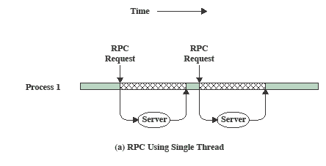
RPC
Using Single Thread
Notes:
The results are obtained in sequence,
so that the program has to wait for a response from each server in turn.

Slide 19
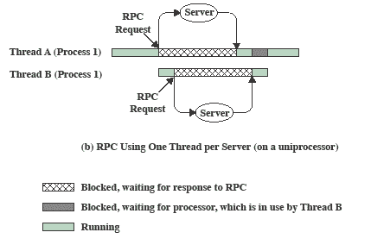
RPC Using
One Thread per Server
Notes:
Rewriting the program to use a separate thread for each RPC results in a substantial speedup.
Note that if this program operates on a uniprocessor, the requests must be generated sequentially and the results processed in sequence;
however, the program waits concurrently for the two replies.

Slide 20
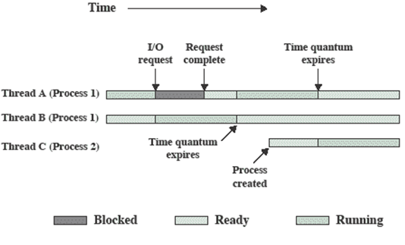
Multithreading on a Uniprocessor
Notes:
On a uniprocessor, multiprogramming enables the interleaving of multiple threads within multiple processes.
In the example,
- three threads in two processes are interleaved on the processor.
- Execution passes from one thread to another either when the currently running thread is blocked or its time slice is exhausted.

Slide 21
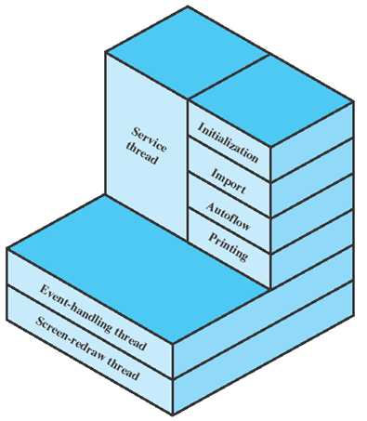
Adobe PageMaker
Three threads are always active:
  an event-handling thread,
  a screen-redraw thread,
  a service thread.
Notes:
An example of the use of threads is the Adobe PageMaker application running under a shared system.
Three threads are always active:
an event-handling thread,
a screen-redraw thread,
a service thread.

Slide 22
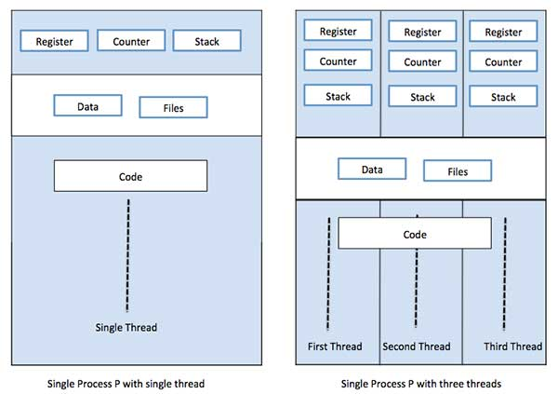
Single Vs multiple threads

Slide 23
Differences
Process | Thread
Process is heavy weight or resource intensive. | Thread is light weight, taking lesser resources than a process.
Process switching needs interaction with operating system. | Thread switching does not need to interact with operating system.
In multiple processing environments, each process executes the same code but has its own memory and file resources. | All threads can share same set of open files, child processes.
If one process is blocked, then no other process can execute until the first process is unblocked. | While one thread is blocked and waiting, a second thread in the same task can run.
Multiple processes without using threads use more resources. | Multiple threaded processes use fewer resources.
In multiple processes each process operates independently of the others. | One thread can read, write or change another thread's data.

Slide 24
Categories of
Thread Implementation
User Level Thread (ULT)
Kernel level Thread (KLT) also called:
  kernel-supported threads
  lightweight processes.

Slide 25
ULT
The thread management kernel is not aware of the existence of threads.
The thread library contains code for creating and destroying threads, for passing message and data between threads, for scheduling thread execution and for saving and restoring thread contexts.
The application starts with a single thread.

Slide 26
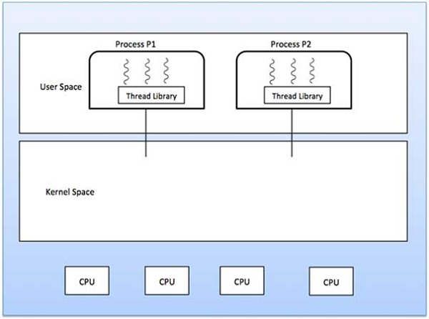

Slide 27
Advantages
Thread switching does not require Kernel mode privileges.
User level thread can run on any operating system.
Scheduling can be application specific in the user level thread.
User level threads are fast to create and manage.
Disadvantages
In a typical operating system, most system calls are blocking.
Multithreaded application cannot take advantage of multiprocessing.

Slide 28
KLT
Thread management is done by the Kernel.
There is no thread management code in the application area.
Kernel threads are supported directly by the operating system.
Any application can be programmed to be multithreaded. All of the threads within an application are supported within a single process.
The Kernel maintains context information for the process as a whole and for individuals threads within the process. Scheduling by the Kernel is done on a thread basis.
The Kernel performs thread creation, scheduling and management in Kernel space. Kernel threads are generally slower to create and manage than the user threads.

Slide 29
Advantages
Kernel can simultaneously schedule multiple threads from the same process on multiple processes.
If one thread in a process is blocked, the Kernel can schedule another thread of the same process.
Kernel routines themselves can be multithreaded.
Disadvantages
Kernel threads are generally slower to create and manage than the user threads.
Transfer of control from one thread to another within the same process requires a mode switch to the Kernel.

Slide 30
Many-to-one
This means multiple threads managed by a library in user space but the kernel is only aware of a single thread of the process owning these threads.
For example, If the currently running thread blocks for input then all other threads are blocked.
For the same reason, the kernel is not going to be able to distribute the other threads on other CPUs if the system has more than one.

Slide 31
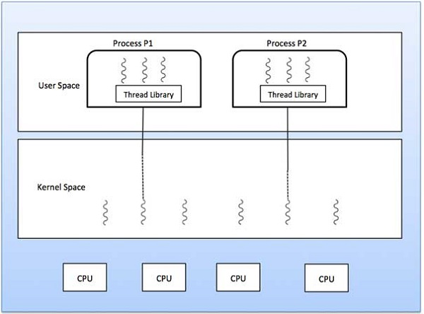
Cont…

Slide 32
One-to-one
Process threads are managed by the kernel so there are separate kernel threads for each process thread.
Since the kernel is aware of all threads, if one thread blocks it does not affect the others.
Also, threads can run on different CPUs or cores. Finally, the management overhead is significant.

Slide 33
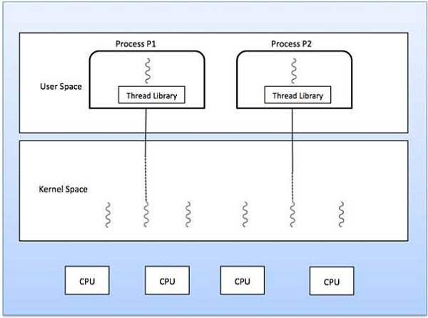
Cont…

Slide 34
Many-to-many
This model is the rarest of the implementations.
It multiplexes many user level threads to many kernel threads. The goal is to get the benefits of the other models without the downsides, however there is no such free lunch in life so it comes with an implementation difficulty.

Slide 35
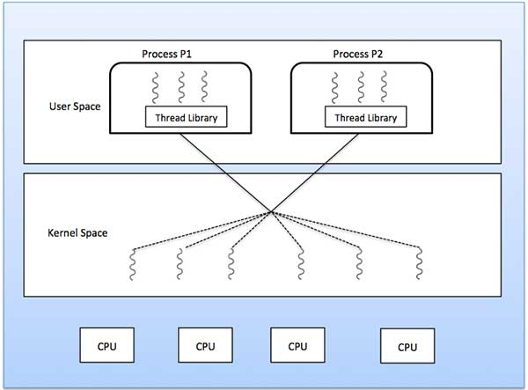
Cont…

Slide 36
Differences
User Level Threads | Kernel Level Threads
User-level threads are faster to create and manage. | Kernel-level threads are slower to create and manage.
Implementation is by a thread library at the user level. | Operating system supports creation of Kernel threads.
User-level thread is generic and can run on any operating system. | Kernel-level thread is specific to the operating system.
Multi-threaded applications cannot take advantage of multiprocessing. | Kernel routines themselves can be multithreaded.

Slide 37
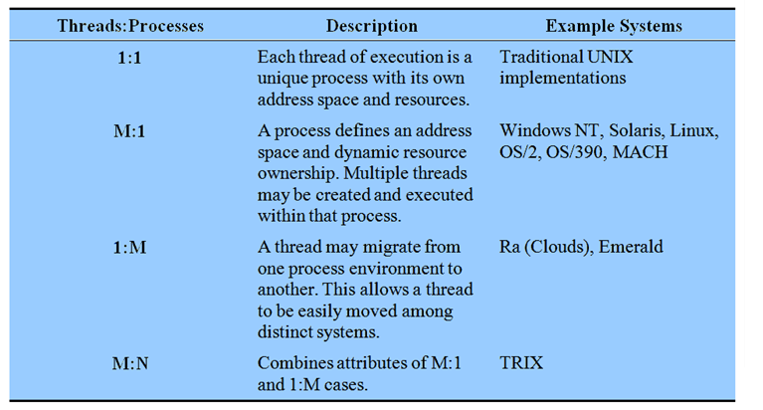
Relationship Between
Thread and Processes
Notes:
The concepts of resource allocation and dispatching unit have traditionally been embodied in the single concept of the process; that is, as a 1 : 1 relationship between threads and processes.
There has been much interest in providing for multiple threads within a single process, which is a many-to-one relationship
.
However, as the table shows, the other two combinations have also been investigated, namely,
a many-to-many relationship and
a one-to-many relationship.

Slide 38
Traditional View
Traditionally, the computer has been viewed as a sequential machine.
  A processor executes instructions one at a time in sequence
  Each instruction is a sequence of operations
Two popular approaches to providing parallelism
  Symmetric MultiProcessors (SMPs)
  Clusters
Notes:
Traditionally, the computer has been viewed as a sequential machine.
Most computer programming languages require the programmer to specify algorithms as sequences of instructions.
A processor executes programs by executing machine instructions in sequence and one at a time. Each instruction is executed in a sequence of operations
(fetch instruction, fetch operands, perform operation, store results).
This view of the computer has never been entirely true.
As computer technology has evolved and as the cost of computer hardware has dropped, computer designers have sought more and more opportunities for parallelism, usually to improve performance and, in some cases, to improve reliability.
the two most popular approaches to providing parallelism by replicating processors:
symmetric multiprocessors (SMPs) and
clusters.

Slide 39
Categories of
Computer Systems
Single Instruction Single Data (SISD) stream
  Single processor executes a single instruction stream to operate on data stored in a single memory
Single Instruction Multiple Data (SIMD) stream
  Each instruction is executed on a different set of data by the different processors
Notes:
It is useful to see where SMP architectures fit into the overall category of parallel processors.

Slide 40
Categories of Computer Systems
  Multiple Instruction Single Data (MISD) stream (Never implemented)
  A sequence of data is transmitted to a set of processors, each of execute a different instruction sequence
Multiple Instruction Multiple Data (MIMD)
  A set of processors simultaneously execute different instruction sequences on different data sets

Slide 41
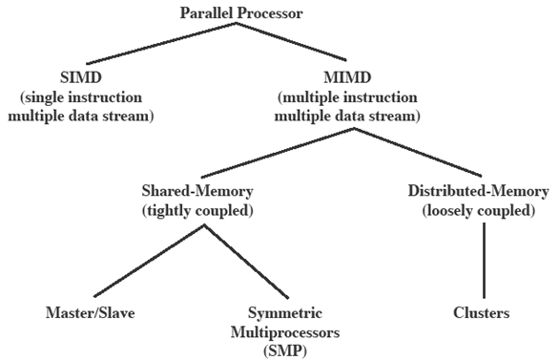
Parallel Processor
Architectures
Notes:
With the MIMD organization, the processors are general purpose, because they must be able to process all of the instructions necessary to perform the appropriate data transformation.
MIMDs can be subdivided by the means in which the processors communicate.
If the processors each have a dedicated memory, then each processing element is a self-contained computer.
Such a system is known as a cluster, or multicomputer.
If the processors share a common memory, then each processor accesses programs and data stored in the shared memory, and processors communicate with each other via that memory;
sucha system is known as a shared-memory multiprocessor.

Slide 42
Symmetric
Multiprocessing
Kernel can execute on any processor
  Allowing portions of the kernel to execute in parallel
Typically each processor does self-scheduling from the pool of available process or threads
Notes:
In a symmetric multiprocessor (SMP),
the kernel can execute on any processor, and
typically each processor does self-scheduling from the pool of available processes or threads.
The kernel can be constructed as multiple processes or multiple threads, allowing portions of the kernel to execute in parallel. This complicates the OS.
It must ensure that two processors do not choose the same process and that processes are not somehow lost from the queue.
Techniques must be employed to resolve and synchronize claims to resources.

Slide 43
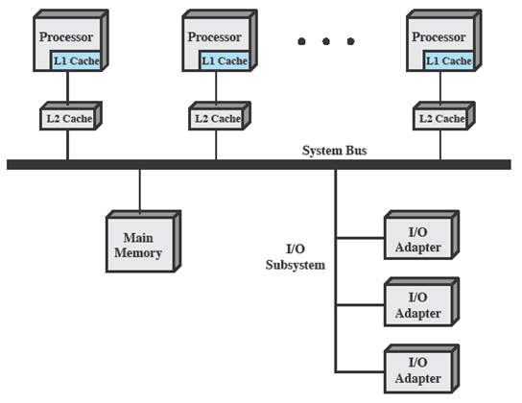
Typical
SMP Organization
Notes:
There are multiple processors, each of which contains its own
control unit,
arithmetic-logic unit, and
registers.
Each processor has access to a shared main memory and the I/O devices through some form of interconnection mechanism; a shared bus is a common facility.
The processors can communicate with each other through memory (messages and status information left in shared address spaces).
It may also be possible for processors to exchange signals directly. The memory is often organized so that multiple simultaneous accesses to separate blocks of memory are possible.

Slide 44
Multiprocessor OS
Design Considerations
The key design issues include
  Simultaneous concurrent processes or threads
  Scheduling
  Synchronization
  Memory Management
  Reliability and Fault Tolerance
Notes:
Talk through each of the issues
Simultaneous concurrent processes or threads:
Kernel routines need to be re-entrant to allow several processors to execute the same kernel code simultaneously.
With multiple processors executing the same or different parts of the kernel, kernel tables and management structures must be managed properly to avoid deadlock or invalid operations.
Scheduling:
Scheduling may be performed by any processor, so conflicts must be avoided.
If kernel-level multithreading is used, then the opportunity exists to schedule multiple threads from the same process simultaneously on multiple processors.
Synchronization:
With multiple active processes having potential access to shared address spaces or shared I/O resources, care must be taken to provide effective synchronization.
Synchronization is a facility that enforces mutual exclusion and event ordering.
A common synchronization mechanism used in multiprocessor operating systems is locks
Memory management:
Memory management on a multiprocessor must deal with all of the issues found on uniprocessor computers.
The also OS needs to exploit the available hardware parallelism, such as multiported memories, to achieve the best performance.
The paging mechanisms on different processors must be coordinated to enforce consistency when several processors share a page or segment and to decide on page replacement.
Reliability and fault tolerance:
The OS should provide graceful degradation in the face of processor failure.
The scheduler and other portions of the OS must recognize the loss of a processor and restructure management tables accordingly.

